Slide 1


Slide 2
Bureau of Accountability Reporting Updates
Technical Assistance Meeting
April 2019
Notes:
Welcome!

Slide 3
Presenter
Tracy Halley
Bureau Chief
Bureau of Accountability Reporting
Accountability@fldoe.org

Slide 4
Bureau Contact Information Update
Bureau Phone: 850-245-0411
Bureau Emails:
Accountability@fldoe.org
VAM@fldoe.org
ClassRoster@fldoe.org (RVT)

Slide 5
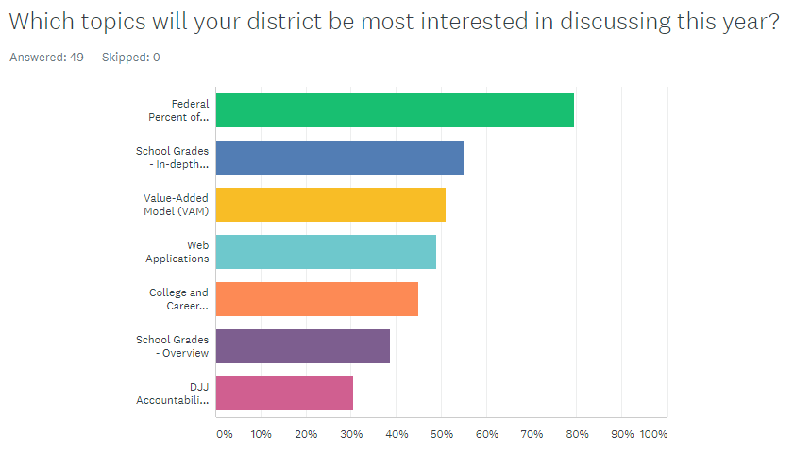

Slide 6
Topics
DJJ Accountability System
VAM Process
School Grades and School Improvement Ratings
Federal Percent of Points Index
Additional Information
  Subgroup definitions across platforms
  Industry Certifications
Helpful Single Sign On (SSO) Information
Application Review

Slide 7
DJJ Accountability System

Slide 8
DJJ Accountability System
(A maximum of 11 measures)
The rating is based on the percentage of total points earned, and programs are rated based only on the components for which they have sufficient data
Components are classified on a 3-point scale before being combined
Cut-scores used to determine classification are specific to each program type/component combination
Learning Gains
K-12 Outcomes
Educator Quality
Post-K-12 Outcomes
Process Measures
FSA English and Language Arts (0% to 100%)
Increased Attendance (0% to 100%)
Core Courses Taught by Qualified Teachers (0% to 100%)
Postsecondary Enrollment (0% to 100%)
Common Assessment Data Quality (0% to 100%)
FSA Mathematics (0% to 100%)
Industry Certifications (0% to 100%)
Employment (0% to 100%)
Common Assessment Reading (0% to 100%)
Graduation (0% to 100%)
Common Assessment Math (0% to 100%)
Simulation 1 2014-2015
Simulation 2 - 2015-2016 Informational Baseline Data - 1617
Expected Spring of 2020

Slide 9
1 - Attendance Component
The percentage of eligible (40 days) students whose non-DJJ attendance the year following their DJJ enrollment is greater than it was the year prior to DJJ enrollment or who maintained 95% attendance or above.
Numerator: Number of eligible (40 days) students who increased their attendance rate
Denominator: Number of eligible (40 days) students with an enrollment record in a non-DJJ school the year before and the year after the year of eligibility

Slide 10
2 - Graduation Component
The percentage of eligible (40 days) 12th grade students who graduated or earned a GED in the year of eligibility or subsequent year. Graduates in the year of eligibility enrolled in grades below 12th grade are also included.
Numerator: Number of eligible (40 days) 12th graders who received a standard diploma or earned a GED in the year of eligibility or subsequent year + eligible non-12th graders that graduated in the year of eligibility
Denominator: Number of eligible (40 days) 12th grade students + eligible non-12th graders that graduated in the year of eligibility

Slide 11
3 – CAPE Certification Component
(Career and Professional Education)
The percentage of eligible (40 days) students who earn a CAPE Industry Certification (High School) in the year of eligibility or subsequent year
Numerator: Number of eligible (40 days) students who earned a CAPE certification during the year of eligibility or subsequent year
Denominator: Number of eligible (40 days) students who were served by DJJ programs with a contracted minimum length of stay of 9 months or longer

Slide 12
4 – Qualified Teachers Component
The percentage of core courses taught by teachers qualified for the subject area
Numerator: Number of core courses taught by qualified teachers
Denominator: Number of core courses taught at each DJJ program

Slide 13
5- Postsecondary Component
The percentage of students who graduated in the year of eligibility who enrolled in a postsecondary institution in the state of Florida during the year of eligibility or subsequent year. Non-graduates enrolled in postsecondary institutions in the year of eligibility are also included.
Numerator: Number of eligible (40 days) released graduates in the year of eligibility who enrolled in a postsecondary institution in the state of Florida during the year of eligibility or subsequent year + released non-graduates enrolled in postsecondary in the year of eligibility
Denominator: Eligible (40 days) students who were both released from the DJJ program and graduated with a diploma or GED in the year of eligibility + released non-graduates enrolled in postsecondary in the year of eligibility

Slide 14
6 - Employment Component
The percentage of students who gained employment within one year following release from the DJJ program Those that were enrolled in PK-12 or postsecondary education or who were under the age of 16 at the time of release were excluded unless they were also employed
Numerator: Number of eligible (40 days) released students who gained employment within 1 year after release date
Denominator: Number of eligible (40 days) students who were released from the DJJ program
Notes:
The employment component examines the percentage of eligible students who were released from their DJJ program in the year of eligibility who gained employment within one year following their release. Data are provided by the Florida Education and Training Placement Information Program (FETPIP), a data collection and consumer reporting system established by s. 1008.39, F.S., to provide follow-up data on former students and program participants who have graduated, exited or completed a public education or training program within the State of Florida. FETPIP receives wage data from the Florida Department of Revenue quarterly. Students with reported wage data in any of the four quarters following their release date are considered employed.
Those that were enrolled in PK-12 or postsecondary education were excluded from this component unless they were also employed.

Slide 15
FSA Learning Gains-
7. English Language Arts (ELA)
8. Mathematics
The percentage of eligible (40 days) students who demonstrate learning gains on ELA and Math assessments as measured by s. 1008.22 F.S.
Numerator: Number of eligible (40 days) students who demonstrate learning gains on ELA or Math assessments as measured by s. 1008.22 F.S.
Denominator: Number of served eligible (40 days) students who have a standard assessment during the year of eligibility after they’ve been in the program for 40 calendar days and a prior year standard assessment

Slide 16
Common Assessment Learning Gains Components-
9. Reading
10.Mathematics
The percentage of students who demonstrate learning gains on the DJJ Common Assessment
Numerator: Number of eligible (40 days) whose percentage of correct answers on the post assessment is higher than on the pre assessment or maintains a 100%
Denominator: Number of eligible (40 days) students who have both a pre and a post Common Assessment

Slide 17
11 - Data Integrity Component
The percentage of students who have pre and post test data on the common assessment required by s. 1003.52 (3)(b), F.S., within the timeframe required by s.1003.51 (2)(g), F.S. Pre-test within 10 calendar days of entry Post-test prior to release
Numerator: Number of eligible (40 days) students who were released from the DJJ program that have a pre and post assessment during their program stay.
Denominator: Number of eligible (40 days) students who were released from the DJJ program

Slide 18
Timeline
September 2018
  Rule 6A-1.099812, Florida Administrative Code (F.A.C.), Education Accountability for Department of Juvenile Justice Education Programs, was adopted by the State Board of Education in September 2018, and outlines the DJJ accountability system framework.
February 2019
  DOE released 1718 Simulated DJJ Accountability Ratings based on students that attended a DJJ program for at least 40 days in 2015-16.
Spring 2019
  DOE publishes informational baseline 1st year DJJ ratings using approved cut scores. These ratings are on students that attended a DJJ program for at least 40 days during 2016-17, and will include the 8 existing measures for which complete data are available.
Spring 2020
  DOE releases 2nd year of DJJ ratings, and Bureau of School Improvement begins working with unsatisfactory schools to improve performance under provisions of SBE Rule 6A-1.099813, FAC.

Slide 19
VAM Review, Results, and Process

Slide 20
VAM Review
Data Visualization Tool procurement
  Provides transparency into VAM scores
  Aids teachers and administrators an easy way to
    Understand what a VAM score is
    How to best use a VAM score
Optional use in teacher evaluations
  Effective 1718

Slide 21
VAM Review
Statutory references to Approved Growth Model
  Section 1004.04(4)(a)3.c., F.S.: Continued approval for teacher preparation programs
  Section 1012.56(7)(c), F.S.: One-year extension of a temporary certificate based on Effective or Highly Effective VAM rating
  Section 1012.731(3)(a)2., F.S.: Beginning in 2020-21, allows a classroom teacher to qualify for the highest award tier (Best and Brightest) without an overall evaluation of Highly Effective if the teacher has a VAM score that is classified as Highly Effective
High Impact Teacher designation

Slide 22
VAM Review
6A-1.099811, Differentiated Accountability State System of School Improvement
  Approved by the State Board in July 2018
  Under certain circumstances, requires the teacher’s VAM score to be reviewed when determining teaching assignments at low-performing schools
Any questions about the rule should be directed to the Bureau of School Improvement BSI@fldoe.org

Slide 23
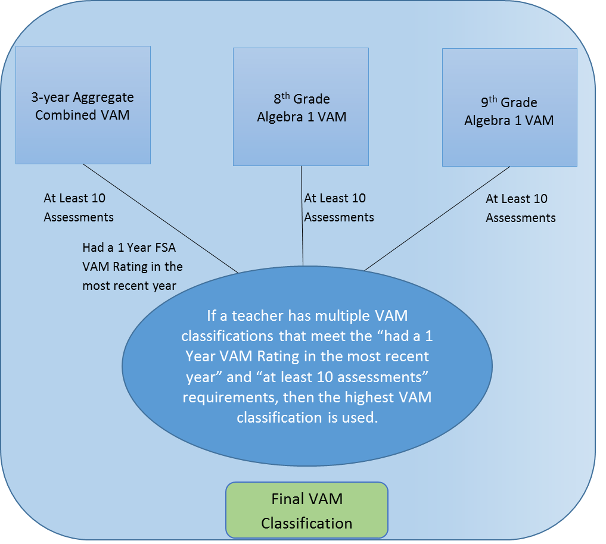
Final VAM Classification

Slide 24
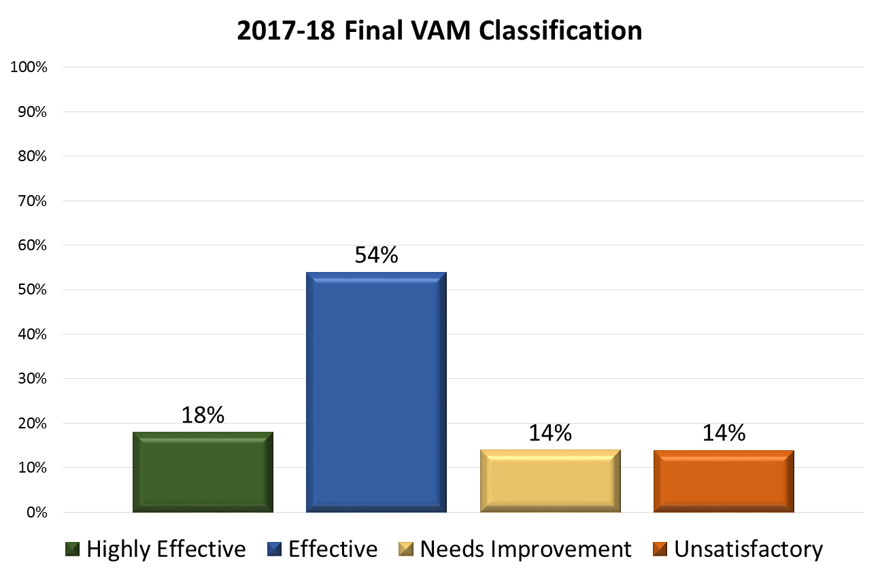

Slide 25
Understanding VAM

Slide 26
VAM Models
Currently, VAM models are generated annually for the following subjects and grades:
English language arts (4th, 5th, 6th, 7th, 8th, 9th, 10th)
Mathematics (4th, 5th, 6th, 7th, 8th)
Algebra 1 (8th & 9th)

Slide 27
Covariates
ELA/Mathematics
    Up to 2 prior test scores
    Number of subject relevant courses
    Disabilities
    English language learner status
    Gifted status
    Attendance
    Mobility
    Difference from modal age of peers in the same grade
    Class size
    Similarity of prior test scores among students in the class

Slide 28
Covariates (Continued)
Algebra I covariates – same as ELA and Mathematics except 3 more are added:
    Average prior test score in the class
    Percentage of students in the class who are gifted
    Percentage of students at modal grade in the class

Slide 29
Value-Added Results and Scores
The formula produces a value-added score for a teacher, which reflects the average amount of learning growth of the teacher’s students above or below the expected learning growth of similar students in the state, using the variables accounted for in the model.
A score of “0” indicates that, on average, students performed no better or worse than expected based on the factors in the model
A positive score indicates that students, on average, performed better than expected
A negative score indicates that students, on average, performed worse than expected

Slide 30
Standard Error
An estimate of a teacher’s impact on student learning (the score) contains some variability.
The standard error is a statistical term that describes that variability.
Using the standard error to construct a confidence interval around a score (like the +/-3 points in an opinion poll) is a good statistical practice that can assist in increasing the accuracy of classification decisions.

Slide 31
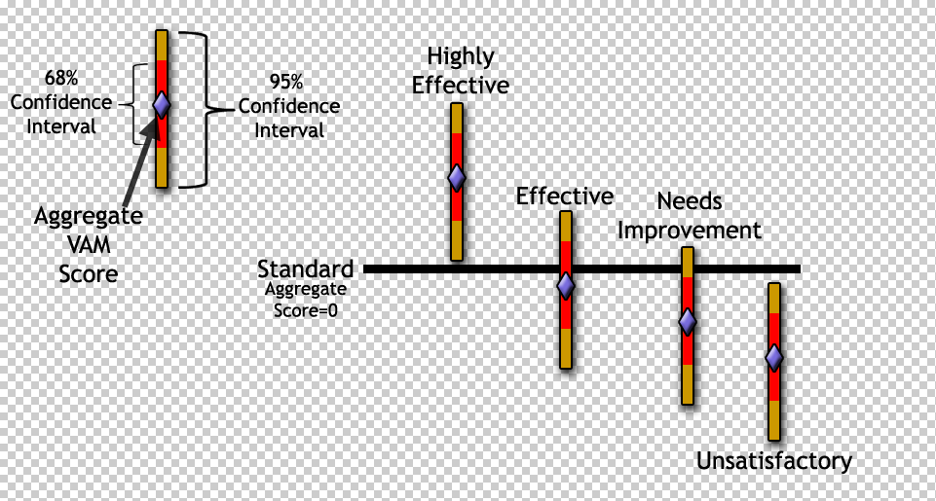
Value-Added Performance-Level Standards

Slide 32
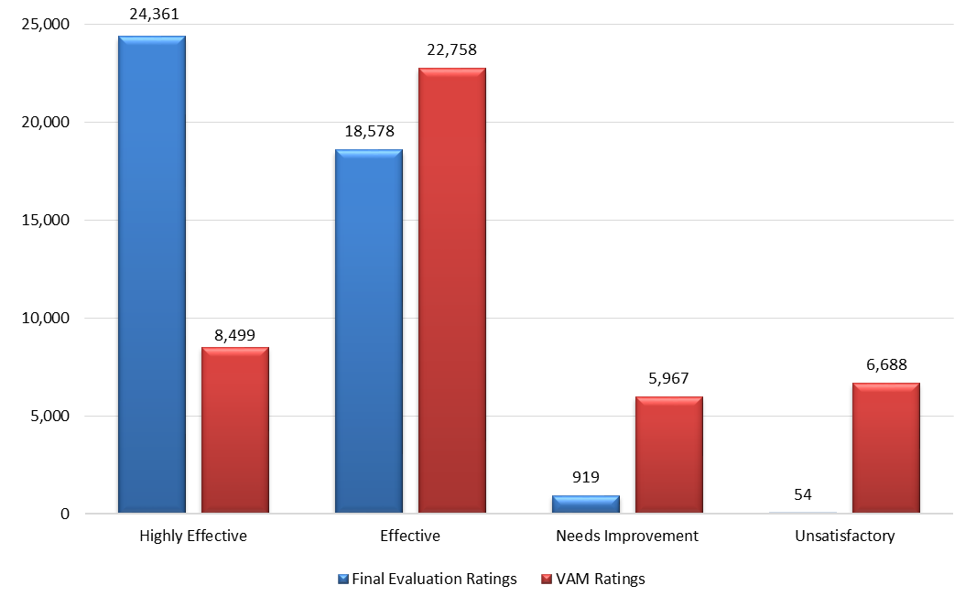
2017-18 District Final Evaluation Rating Compared to VAM Score Classification

Slide 33
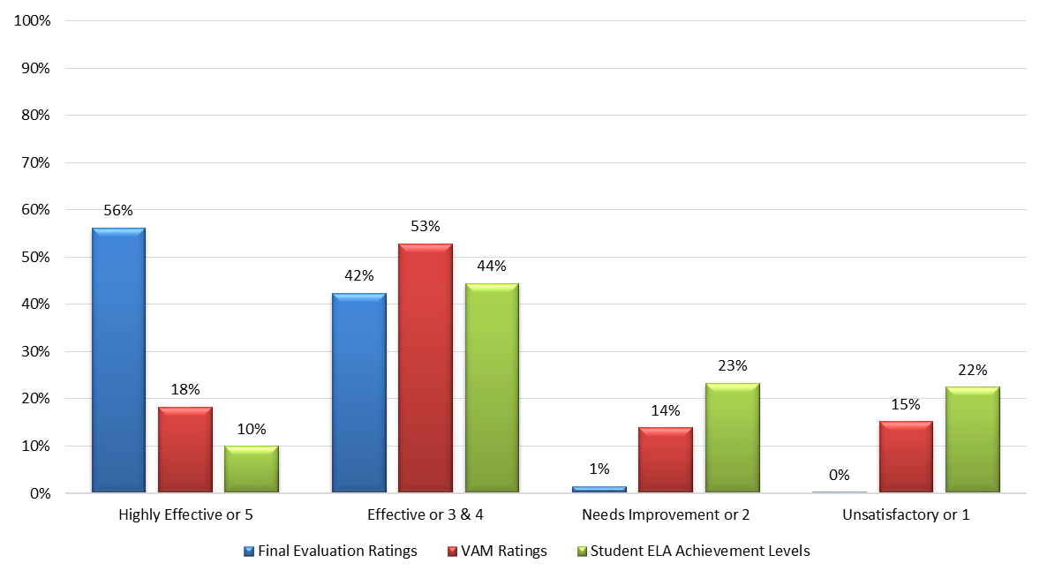
2017-18 Teacher Ratings Compared to Student Achievement

Slide 34
VAM Results
Impact analysis
  VAM vs. Mean Prior Test Score
  VAM vs. % SWD
  VAM vs. % ELLs
  VAM vs. % ED
  VAM vs. % Gifted
  VAM vs. % non-white
2017-18 Analysis same as historical results
  No impact/relationship between VAM score and roster composition

Slide 35
Roster Verification Tool (RVT)
Section 1012.34(1)(a), Florida Statutes, requires districts to “provide instructional personnel the opportunity to review their class rosters for accuracy and to correct any mistakes”
To assist districts in complying with this provision of statute, the Florida Department of Education has created an online Roster Verification Tool (RVT) for optional use
Opens twice a year:
  Fall (Survey 2 Verification)
  Spring (Survey 3 Verification)

Slide 36
Roster Verification Tool (RVT)
FLDOE collects student- and teacher-level information at scheduled times during the reporting year, via student and staff database surveys
  Survey 2 week occurs during October
  Survey 3 week occurs during February
Once state processing for Survey 2 (fall) or Survey 3 (spring) has closed, we pull and load the data into RVT

Slide 37
Student Demographic (Surveys 2 & 3)
Definition
Student_ID
DISTRICT
SCHOOL
DISTRICT_INST
SCHOOL_INST
YEAR
SURVEY
FIRST_NAME
LAST_NAME
MIDDLE_NAME
SEX
ALIAS_ID_SSN
STUDENT_ID_LOCAL
DOB
GRADE
ETHNICITY
RACE (constructed variable)
Student id
District of enrollment
School of enrollment
District of instruction
School of instruction
Year
Survey
Student’s first name
Student’s last name
Student’s middle name
Student’s gender
Alias student id
Local student id
Students date of birth
Student’s grade
Hispanic (Y/N)
Student’s race

Slide 38
Student Course (Surveys 2 & 3)
Definition
DISTRICT_INST
SCHOOL_INST
STUDENT_ID
SURVEY
YEAR
TERM
BEGIN_PERIOD
END_PERIOD
COURSE
SECTION
District of instruction
School of instruction
Student id
Survey data reported
Year data reported
Term
Begin period
End period
Course number
Section number

Slide 39
Teacher Course (Surveys 2 & 3)
Definition
DISTRICT_INST
SCHOOL_INST
SSN
SURVEY
YEAR
TERM
BEGIN_PERIOD
END_PERIOD
COURSE
SECTION
SCHEDULING_METHOD
District of instruction
School of instruction
Teacher id
Survey data reported
Year data reported
Term
Begin Period
End Period
Course number
Section number
Scheduling method

Slide 40
Staff Demographic
Definition
SSN
STAFF_ID_LOCAL
DISTRICT_SERVICE
YEAR
SURVEY
FIRST_NAME
LAST_NAME
MIDDLE_NAME
JOB_CODE_PRIMARY
Teacher id
Local teacher id
District of employment
Year data reported
Survey data reported
Teacher’s first name
Teacher’s last name
Teacher’s middle name
Teacher's primary job code

Slide 41
Roster Verification Tool (RVT)
Once RVT has closed in the Spring, we extract the Survey 2 and Survey 3 data from RVT for districts that opted to use it, and final Survey 2 and Survey 3 data for those that chose to use their own, internal process for roster verification
These are the files used to create the Survey 2-3 match files for VAM purposes

Slide 42
Survey 2-3 Match
If a district does not request a Survey 2-3 match for a school, all students reported on a teacher’s roster on either Survey 2 or Survey 3 will be included in a teacher’s VAM score at that school, even if the student changed schools between surveys
If a district requests a Survey 2-3 match for a school, a student must be at the same school for both Surveys 2 and 3 to be included in a teacher’s VAM score at that school
FLDOE does not calculate a teacher-level match

Slide 43
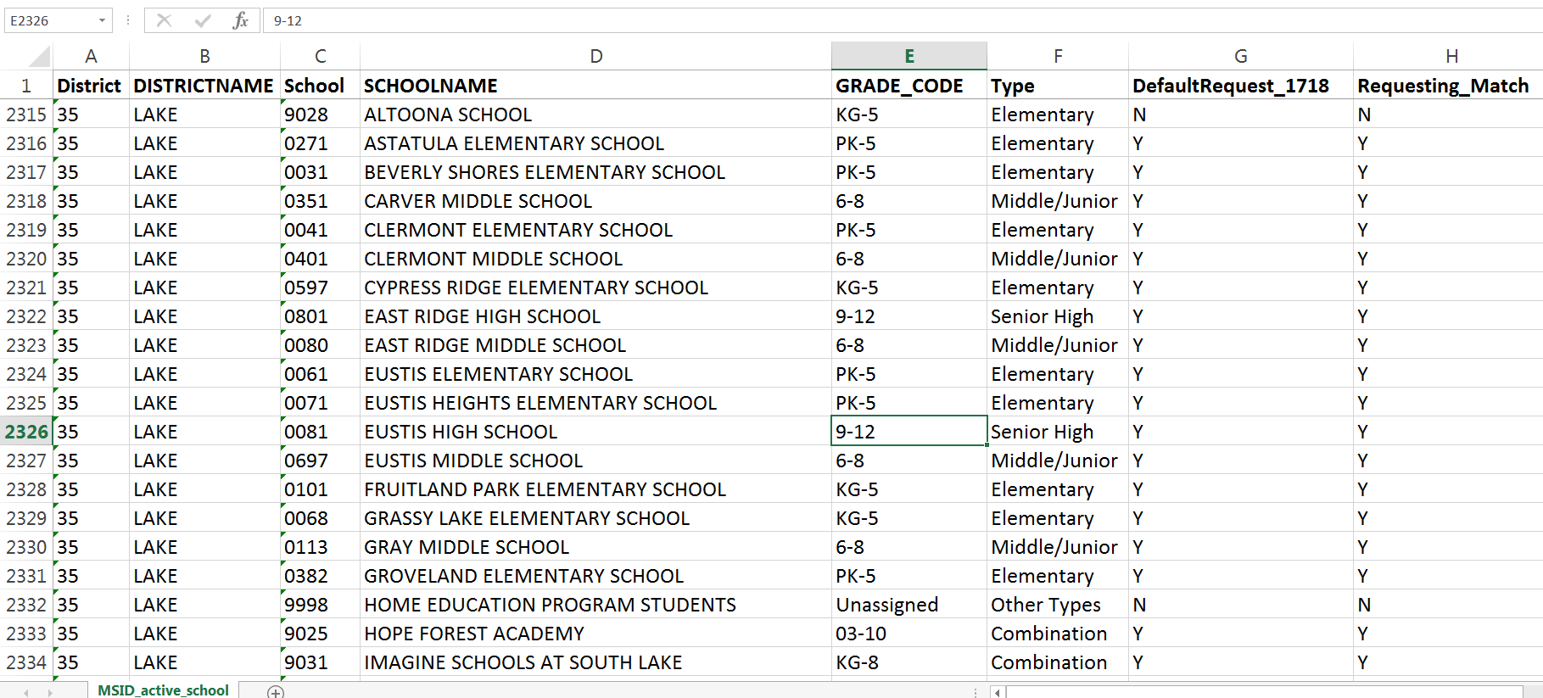
Survey 2-3 Match
FLDOE will provide each district with their Survey 2-3 match requests from last year on Sharefile in the beginning of April to review and edit

Slide 44
Survey 2-3 Match
Once RVT closes and all match requests are in, Survey 2 and 3 RVT data is pulled for districts that used the tool, and all final Survey 2 and 3 data is pulled for those districts that used their own process for verification
FLDOE applies the Survey 2-3 match for those schools that districts requested a match be done
FLDOE places the Survey 2-3 match files on Sharefile for final review from districts (second week of May)

Slide 45
Variable (Survey 2-3 Files)
Definition
DOESTUDENTID
ALIAS
LOCALID
FIRSTNAME
LASTNAME
MIDDLENAME
GENDER
DATEOFBIRTH
RACE
GRADE
SURVEY
DISTRICTID
SCHOOLID
SCHOOLNAME
TERM
SECTIONNUMBER
PERIODBEGIN
Student id
Alias student id
Local student id
Student’s first name
Student’s last name
Student’s middle name
Student’s gender
Students date of birth
Student’s race
Student’s grade
Survey class information reported
District number
School number
School name
Term
Section number
Begin period

Slide 46
Variable (Survey 2-3 Files)
Definition
PERIODEND
SCHEDULINGMETHOD
COURSENUMBER
COURSENAME
COURSETYPE
SCHEDULINGMETHODDESC
TEACHERSSN
STAFFIDLOCAL
TEACHERFIRSTNAME
TEACHERLASTNAME
TEACHERMIDDLE
SCHOOL_FULL_YEAR
DISTRICT_FULL_YEAR
REQUEST_MATCH
INCLUDE_IN_VAM_ORG
INCLUDE_IN_VAM_EDIT
End period
Scheduling method
Course number
Course name
Course type (postsecondary vs not)
Scheduling method description
Teacher id
Local teacher id
Teacher first name
Teacher last name
Teacher middle name
Student in school for both surveys (Y/N)
Student in district for both surveys (Y/N)
District requested match for school (Y/N)
Record included in VAM score (Y/N)
Record should be included in VAM (Y/N)

Slide 47
Survey 2-3 Match
Districts verify Survey 2/3 requests were applied correctly
If edits are needed, districts make these changes and repost edited files to Sharefile
District accountability contact in every district replies to FLDOE that files were compiled accurately or that all necessary edits have been made and returned to FLDOE by June 7, 2019

Slide 48
VAM Timeline
Month | Activity
December | Amendment window closes for Survey 2 data; data is final (December 15, 2018)
January | Fall Survey 2 RVT Opens (January 7, 2019)
February | Fall Survey 2 RVT is open
March | Fall Survey 2 RVT closes (March 1, 2019) Spring Survey 3 RVT open (March 25, 2019)
April | Survey 2/3 match request list files from prior year posted to ShareFile for districts to update Amendment window closes for Survey 3 data; data is final (April 15, 2019) Spring Survey 3 RVT closes (April 26, 2019) Changes to Survey 2/3 match request list file for VAM calculation purposes are due (April 26, 2019)

Slide 49
VAM Timeline
Month | Activity
May | Data is extracted from RVT for those districts that opted to use it and final survey data is pulled for districts that opted to use their own internal verification process (first week of May) FLDOE applies the Survey 2-3 match for those schools that districts requested a match be done FLDOE places the Survey 2-3 match files on Sharefile for final review from districts (second week of May)
June | Districts verify Survey 2/3 requests were applied correctly If edits are needed, districts make these changes and repost the edited files to Sharefile District accountability contact in every district replies to FLDOE that files were compiled accurately or that all necessary edits have been made and returned to FLDOE (June 7, 2019)
July | Processes VAM calculations for FSA ELA,FSA Mathematics, and Algebra I
August | FLDOE posts VAM results for teachers to school districts via ShareFile website (second or third week)

Slide 50
School Grades and School Improvement Rating
Calculation Components
Technical Assistance Meeting
Tallahassee, FL
April 2, 2019

Slide 51
Presenter
Justin Tarin
Bureau of Accountability Reporting
accountability@fldoe.org

Slide 52
School Grades

Slide 53
School Grades Model
Focuses the school grading formula on student success measures:
  Achievement
  Learning gains
  Graduation
  Earning College Credit and/or Industry Certifications
Maintains focus on students who need the most support
ELLs included in Achievement after 2 years

Slide 54
School Grades
Schools are only graded on the components for which they have sufficient data
  Schools with enough data for one or more components will receive a grade

Slide 55
Percent Tested
Must test 95% of Survey 3 students
Calculated for each assessment and then aggregated
Schools that do not test 95% of students will receive preliminary grades of “I”
  Superintendents can appeal the “I” by demonstrating that the data accurately represents the school’s progress or requesting that late reporting assessment results be included
  Commissioner will review data to determine if the performance data is representative of the school’s progress
  If Commissioner determines the data is representative, he will release grades for these schools at the end of the appeals period

Slide 56
Subject Areas Included for Achievement
The Percentage of Full-Year Enrolled Students who scored at Level 3 or above in:
  English Language Arts
    Florida Standards Assessment in English Language Arts - Grade 3 to 10
  Mathematics*
    Florida Standards Assessment in Mathematics - Grades 3 to 8
    Algebra 1 EOC
    Geometry EOC
  Science*
    Science - Grades 5 and 8
    Biology 1 EOC
  Social Studies*
    Civics
    U.S. History
*For EOCs, a student must be enrolled in the course to be counted in achievement.

Slide 57
FSA Learning Gains Criteria
English Language Arts and Mathematics
Improve one or more achievement levels from one year to the next (e.g., move from Level 1 to Level 2; Level 2 to Level 4, etc.)
Maintain a Level 3 or Level 4 and the student’s scale score must have improved from one year to the next
For students who remain in Level 1 or Level 2, split Levels 1 and 2 into multiple sections (Level 1 into thirds and Level 2 in half) and require the student to improve from section to section within the Level (e.g., move from the bottom third of Level 1 to the middle third of Level 1)
Maintain a Level 5 from one year to the next

Slide 58
FSAA Learning Gains Criteria
English Language Arts and Mathematics
Improve one or more achievement levels from one year to the next (e.g., move from Level 1 to Level 2; Level 2 to Level 4, etc.)
For students who remain in Level 1 or Level 2, split Levels 1 and 2 into multiple sections (Level 1 into thirds and Level 2 in half) and require the student to improve from section to section within the Level (e.g., move from the bottom third of Level 1 to the middle third of Level 1)
For students who remain in Level 3, split Level 3 into two sections and require the student to improve from section to section within the Level (e.g., move from the bottom half of Level 3 to the top half of Level 3) or remain in the same section
Maintain a Level 4 from one year to the next

Slide 59
Learning Gains Reminder
A learning gain can be made using prior and current like tests only
A gain cannot be made from a prior year FSAA to current year FSA, or a prior year FSA to current year FSAA

Slide 60
Learning Gains of the Lowest 25%
Calculated for both English Language Arts and Mathematics
Applies the same learning gains methodology to the lowest performing 25% of students
Determining the lowest performing 25% of students
  Uses the performance of students in the prior year calculated at each grade level to identify the lowest performing 25% of students (EOCs not by grade level)
  Low 25% is not limited to students in Achievement Levels 1 and 2

Slide 61
Middle School Acceleration
The percentage of eligible students who passed one or more high school level statewide, standardized end-of-course (EOC) assessments or attained industry certifications identified in the industry certification funding list
Calculated for all schools that include grades 6, 7, and 8 or grades 7 and 8
Eligible students include full-year-enrolled students, who are current-year grade 8 students who scored at or above Achievement Level 3 on the Mathematics statewide assessments in the prior year, or are full-year-enrolled students in grades 6, 7, or 8 that took high school level EOC assessments or industry certifications
  Industry certification data is the most recent available and lags by one year.
Students must be enrolled in the course to be included
A student is included in the calculation no more than once

Slide 62
Graduation Rate
The most recent 4-year cohort graduation rate measured according to 34 § CFR 200.19
Calculated for all schools that include grades 9 to 12, grades 10 to 12, and grades 11 and 12
Also calculated for combination schools that include these grade levels

Slide 63
College and Career Acceleration
Cohort-based calculation using the graduates from the graduation rate calculation as the denominator
The percentage of graduates who, while in high school,
  earned college credit through AP, IB, or AICE examinations;
  earned a C- or better in an eligible dual enrollment course; or
  earned a CAPE industry certification

Slide 64
Elementary School Grades Model
(A maximum of 7 components)
School grade is based on the percentage of total points earned, and schools are graded based only on the components for which they have sufficient data
English Language Arts
Achievement (0% to 100%)
Learning Gains (0% to 100%)
Learning Gains of the Low 25% (0% to 100%)
Mathematics
Achievement (0% to 100%)
Learning Gains (0% to 100%)
Learning Gains of the Low 25% (0% to 100%)
Science
Achievement (0% to 100%)

Slide 65
Middle School Grades Model
(A maximum of 9 components)
School grade is based on the percentage of total points earned, and schools are graded based only on the components for which they have sufficient data
English Language Arts
Achievement (0% to 100%)
Learning Gains (0% to 100%)
Learning Gains of the Low 25% (0% to 100%)
Mathematics
Achievement (0% to 100%)
Learning Gains (0% to 100%)
Learning Gains of the Low 25% (0% to 100%)
Science
Achievement (0% to 100%)
Social Studies
Achievement (0% to 100%)
Middle School Acceleration
Middle School (EOC or industry certification) (0% to 100%)

Slide 66
High School Grades Model
(A maximum of 10 components)
School grade is based on the percentage of total points earned, and schools are graded based only on the components for which they have sufficient data
English Language Arts
Achievement (0% to 100%)
Learning Gains (0% to 100%)
Learning Gains of the Low 25% (0% to 100%)
Mathematics
Achievement (0% to 100%)
Learning Gains (0% to 100%)
Learning Gains of the Low 25% (0% to 100%)
Science
Achievement (0% to 100%)
Social Studies
Achievement (0% to 100%)
Graduation Rate
Overall, 4-year Graduation Rate (0% to 100%)
College and Career Acceleration
High School (AP, IB, AICE, dual enrollment or industry certification) (0% to 100%)

Slide 67
Combination School Grades Model
(A maximum of 11 components)
School grade is based on the percentage of total points earned, and schools are graded based only on the components for which they have sufficient data
English Language Arts
Achievement (0% to 100%)
Learning Gains (0% to 100%)
Learning Gains of the Low 25% (0% to 100%)
Mathematics
Achievement (0% to 100%)
Learning Gains (0% to 100%)
Learning Gains of the Low 25% (0% to 100%)
Science
Achievement (0% to 100%)
Social Studies
Achievement (0% to 100%)
Middle School Acceleration
Middle School (EOC or industry certification) (0% to 100%)
Graduation Rate
Overall, 4-year Graduation Rate (0% to 100%)
College and Career Acceleration
High School (AP, IB, AICE, dual enrollment or industry certification) (0% to 100%)

Slide 68
School Grade Scale
A = 62 percent of total applicable points or higher
B = 54 to 61 percent of total applicable points
C = 41 to 53 percent of total applicable points
D = 32 to 40 percent of total applicable points
F = 31 percent of total applicable points or less

Slide 69
Calculating the School Grade
The school’s grade is determined by:
  Summing the points earned for each component (each component is worth 100 points) and dividing by the number of components with sufficient data
  The percentage resulting is the percentage of points the school earned from all applicable components
  This percentage would be compared to the scale set by the State Board of Education to determine a school’s grade

Slide 70
Example for Calculating the School Grade
English Language Arts
Achievement 41%
Learning Gains 60%
Learning Gains of the Low 25% 53%
Mathematics
Achievement 40%
Learning Gains 55%
Learning Gains of the Low 25% 53%
Science
Achievement 36%
Social Studies
Achievement 53%
Middle School Acceleration
Middle School (EOC or industry certification) 64%
Graduation Rate
Overall, 4-year Graduation Rate 74%
College and Career Acceleration
High School (AP, IB, AICE, dual enrollment or industry certification) 38%
Total Points Earned | Total Components | Percent of Total Possible Points | Grade
567 | 11 | 52% | C
Notes:
K-12 or 7-12.

Slide 71
District Grades
Districts receive grades based on all of the components in the school grades model
Students who were not full-year-enrolled in a school but were full-year-enrolled in the district will be included in the district grade in addition to students included in schools’ grades

Slide 72
District School Grades Model
(A maximum of 11 components)
The district grade is based on the percentage of total points earned, and schools are graded based only on the components for which they have sufficient data
English Language Arts
Achievement (0% to 100%)
Learning Gains (0% to 100%)
Learning Gains of the Low 25% (0% to 100%)
Mathematics
Achievement (0% to 100%)
Learning Gains (0% to 100%)
Learning Gains of the Low 25% (0% to 100%)
Science
Achievement (0% to 100%)
Social Studies
Achievement (0% to 100%)
Middle School Acceleration
Middle School (EOC or industry certification) (0% to 100%)
Graduation Rate
Overall, 4-year Graduation Rate (0% to 100%)
College and Career Acceleration
High School (AP, IB, AICE, dual enrollment or industry certification) (0% to 100%)

Slide 73
School Improvement Ratings

Slide 74
School Improvement Ratings
Alternative schools and exceptional student education (ESE) center schools choose whether to receive a school grade or a school improvement rating
If the school chooses to receive a rating, its students’ performance information is used in both the school’s rating and the students’ home-zoned school’s grade
The department provides the district a list of schools from which to verify the schools that are eligible to choose a rating

Slide 75
Students Tied Back Across Districts
Districts are receiving a file during the Survey 3 processing window that identifies the students being tied back from another district
If the home-zoned district and school need to be updated, you must contact the district of enrollment

Slide 76
School Improvement Ratings
The school improvement rating shall identify an alternative school or ESE center school as having one of the following ratings:
  Commendable: a significant percentage of the students attending the school are making learning gains
  Maintaining: a sufficient percentage of the students attending the school are making learning gains
  Unsatisfactory: an insufficient percentage of the students attending the school are making learning gains

Slide 77
Percent Tested
Schools must assess 80% of students to receive a rating
Schools that assess less than 90% of students are not eligible to receive a rating of Commendable

Slide 78
School Improvement Rating Components
Components
  Learning Gains in English Language Arts (100 points)
  Learning Gains in Mathematics (100 points)
Learning gains are calculated using the method described in the school grades rule
Eligible students include students enrolled in membership survey 2 or 3 and tested
Retake assessments are included when first-time assessments are not available for a student

Slide 79
Calculating the School Improvement Rating
The rating of Commendable, Maintaining, or Unsatisfactory is based on the percentage of possible points earned by each school
Schools will be rated on only those components for which they have sufficient data

Slide 80
School Improvement Rating Scale
Commendable = 50 percent of total applicable points or higher
Maintaining = 49 to 26 percent of total applicable points
Unsatisfactory = 25 percent of total applicable points or lower

Slide 81
School Improvement Rating:
3-Year Aggregate
If a school does not have enough data for at least one component in the current year, the data for that school will be aggregated using the current year and the two most recent years
A school will get a rating if there is enough data for at least one component after aggregation
The same scale applies

Slide 82
ELA Learning Gains:
Concordant Scores
Students with a prior-year achievement level of 1 or 2, and do not make a gain in the current year on a state standardized test, will have their ELA concordant score in the current year be considered, pursuant to Rule 6A-1.09422, F.A.C.
Students who earn the applicable ELA concordant score or higher will count as making a learning gain in the ELA learning gains component
Students will be added to tested and gain numerators and denominators

Slide 83
Mathematics Learning Gains:
Concordant Scores
Students with a prior-year achievement level of 1 or 2, and do not make a gain in the current year on a state standardized test, will have their mathematics concordant score in the current year be considered, pursuant to Rule 6A-1.09422, F.A.C.
Students who earn the applicable mathematics concordant score or higher will count as making a learning gain in the mathematics learning gains component
Students will be added to tested and gain numerators and denominators

Slide 84
Additional Information

Slide 85
Changes 2018-19
Complete elimination of Algebra 2
  Was included as a prior-year test in 1718
All ELLs are required to take FSA in their first year
  We will not be including WIDA as part of percent tested
Appropriate Concordant scores will be used for SIR learning gains based on the students graduation requirement

Slide 86
Appeals Process
Districts have 30 days after the preliminary calculation of school grades and school improvement ratings to appeal
If a school district determines that a different grade or rating should be assigned to a school because of the omission of data, a data miscalculation, or other special circumstances, the school’s grade or rating may be appealed

Slide 87
Questions and Answers
Questions concerning School Accountability can be directed to the Bureau of Accountability Reporting at accountability@fldoe.org or 850-245-0411.

Slide 88
Every Student Succeeds Act - ESSA

Slide 89
Topics
Background and Overview
Calculations
Subgroup Definitions

Slide 90
ESSA Background
Bipartisan federal law signed in December 2015
Amended the Elementary and Secondary Education Act of 1965, replacing No Child Left Behind provisions
Each state had to submit a state plan detailing how it would comply with the new law
With a strong, proven accountability system, Florida was already ahead of most of the nation as it relates to the requirements of ESSA

Slide 91
Florida's ESSA State Plan
Drafted with public input, including workgroup of superintendents
Approved September 26, 2018
Preserves the focus on increased student achievement
No changes to Florida’s state accountability systems
  School Grades
  Differentiated Accountability/School Turnaround
Adds a federal calculation to satisfy ESSA requirements
  New Federal Percent of Points Index (“Federal Index”)

Slide 92
New ESSA Accountability Provisions
Additional focus on reporting of student subgroup performance
Adjustment for schools that test less than 95%
Inclusion of English Language Learner (ELL) proficiency progress as a separate accountability indicator, as required by US Department of Education

Slide 93
95% Requirement
Schools that test less than 95% will have achievement component modified to include non-tested students in denominator to get up to 95% tested, counted as not proficient
Schools that test at least 95% will see no change in this component between school grade and federal index

Slide 94
ELP Progress Component Calculation
The ELP Progress component is worth 100
Denominator – Students who are in kindergarten through 12th grade and are full-year-enrolled in the school, with a valid current-year score and a valid prior-year score, and who have a valid combination of assessments
  Alternate ACCESS to Alternate ACCESS
  ACCESS for ELLs (2.0 and Kindergarten) to ACCESS for ELLs (2.0 and Kindergarten)
Numerator – Students in the denominator that meet one of the following:
  Increase one or more composite proficiency levels to the next highest whole number
  Maintain a composite level of 4 or higher without decreasing a composite level
  Alternate ACCESS - move up one composite scoring category or remain at Proficiency Level P1 (“Entering”) or above without decreasing a scoring category

Slide 95
Federal Index
ESSA Indicator | Florida Component
Academic Achievement – including Student Growth | English Language Arts (ELA) Achievement
 | Mathematics Achievement
 | Learning Gains ELA
 | Learning Gains Mathematics
 | Learning Gains Lowest 25% ELA
 | Learning Gains Lowest 25% Mathematics
Graduation Rate | 4-Year Graduation Rate
School Quality or Student Success | Science
 | Social Studies
 | Middle School – Acceleration
 | High School – College and Career Acceleration
Progress in Achieving English Language Proficiency (ELP) | ELP Progress (new indicator for federal purposes)

Slide 96
Federal Index Calculation
Same student eligibility criteria as School Grades
  This includes Alternative, ESE Centers, DJJ schools, and K-2 and K-3 feeder schools
Schools can get a Federal Index based on as little as one component
School-level Federal Index
  Determines if a school is in comprehensive support and improvement (CS&I)
Subgroup-level Federal Index
  Subgroups Included
    White, Black/African American, Hispanic, Asian, Native American, Multiracial, Pacific Islander, Students with Disabilities, Economically Disadvantaged, and English Language Learners.
  Determines if a school is in targeted support and improvement (TS&I)

Slide 97
Federal Index
Possibility of 12 Components
English Language Arts
Achievement (0% to 100%)
Learning Gains (0% to 100%)
Learning Gains of the Low 25% (0% to 100%)
Mathematics
Achievement (0% to 100%)
Learning Gains (0% to 100%)
Learning Gains of the Low 25% (0% to 100%)
Science
Achievement (0% to 100%)
Social Studies
Achievement (0% to 100%)
Middle School Acceleration
Middle School (EOC or industry certification) (0% to 100%)
Graduation Rate
Overall, 4-year Graduation Rate (0% to 100%)
College and Career Acceleration
High School (AP, IB, AICE, dual enrollment or industry certification) (0% to 100%)
English Language Proficiency Progress
Progress of English Language Learners in Achieving English Language Proficiency (0% to 100%)

Slide 98
Examples for Calculating the Federal Index
English Language Arts
Achievement 41%
Learning Gains 60%
Learning Gains of the Low 25% 53%
Mathematics
Achievement 40%
Learning Gains 55%
Learning Gains of the Low 25% 53%
Science
Achievement 36%
Social Studies
Achievement 53%
Middle School Acceleration
Middle School (EOC or industry certification) 64%
Graduation Rate
Overall, 4-year Graduation Rate 74%
College and Career Acceleration
High School (AP, IB, AICE, dual enrollment or industry certification) 38%
ELP Progress
Progress of English Language Learners in Achieving English Language Proficiency 60%
 | Points Earned | Components | Percent of Points | Overall
School Grades | 567 | 11 | 52% | C
Federal Index | 627 | 12 | 52%
Notes:
K-12 or 7-12.

Slide 99
Race Subgroups
Student Demographic Information (Survey 3)
Definition
Ethnicity
Race: American Indian or Alaska Native
Race: Asian
Race: Black or African American
Race: Native Hawaiian or Other Pacific Islander
Race: White
Hispanic – all students with a Y reported for Ethnicity
Multiracial – non Hispanic students with a Y reported for more than one race
Students who are not Hispanic or Multiracial are grouped with their individual race.

Slide 100
Students with Disabilities Subgroup
Exceptional Student (Survey 3)
Definition
Exceptionality, Primary
Exceptionality, Other
Any student with a status other than L- gifted
  Students whose only classification are a combination of L – gifted, U - Established Conditions, D - occupational therapy, and/or E - physical therapy are not included in the subgroup

Slide 101
Economically Disadvantaged Subgroup
Student Demographic Information (Survey 3)
Definition
Lunch Status
Lunch Status of C, R, 3, D, E, F, and 4

Slide 102
English Language Learners
Subgroup
Student Demographic Information (Survey 3)
Definition
English Language Learners, PK-12
LY and LF
LZ and have been LZ for 2 years or less.
  Proposed New Code is LA
  For 2018-19, districts will need to identify all LZ student that fit this criteria and adjust their code to LA on Student Data Updates

Slide 103
List of Schools Identified Under ESSA for Additional Support
The list is posted at http://www.fldoe.org/academics/essa
The list contains the school’s Federal Index, overall ESSA status (comprehensive (CS&I) or targeted (TS&I) support and improvement), and the subgroups identified for support
This list represents baseline data from the 2017-18 School Year, and no additional action is required
This list provides useful information to plan and allocate resources for school improvement

Slide 104
CS&I and TS&I Criteria
If a school meets any of the following criteria they will be identified for Comprehensive support (CS&I)
  School Grade of D or F
  Graduation Rate of 67 or below
  Federal Index 40 or below
If a school is not identified as CS&I and they meeting any of the following criteria they are identified for Targeted support (TS&I)
  At least one subgroup with a Federal Index of 40 or below.

Slide 105
Summary of the 2017-18 Baseline Data
A total of 553 schools are identified for Comprehensive support (CS&I)
  This includes Florida’s “D” and “F” schools (230 schools)
  The rigor of Florida’s current School Grades system is evidenced by the reality that 51 “D” schools identified here would be unidentified if we solely relied on the Federal Index
  Over half of the 553 schools (299) are ungraded schools, providing an opportunity to engage stakeholders for these alternative, ESE, and DJJ schools
    All 35 of the DJJ schools that received a federal index have been identified as CS&I

Slide 106
Summary of the 2017-18 Baseline Data
A total of 1,952 higher-performing schools are identified for Targeted support (TS&I) to address pockets of performance problems with specific student subgroups
  This stresses the need to be innovative in even our high-performing schools to address the outcomes of all students, particularly students with special needs
  Over half (55%) of the schools identified for Targeted support have only one subgroup identified, and the vast majority (96%) have three or fewer subgroups identified

Slide 107
State, District, and School Report Cards
A new interactive report card will provide the federally required components for the state, district, and school report cards
Includes the following:
  School grade and school grade components, and Federal Index
    Components disaggregated by subgroup
    State-, District-, School-level
  English Language Proficiency Progress
    State-, District-, School-level
  Whether or not the school was identified for support
February there was a soft release of Beta site with an opportunity to provide feedback for improvements before an official launch in Summer 2019
  https://edudata.fldoe.org/

Slide 108
Additional Resources
Florida’s ESSA plan
http://www.fldoe.org/core/fileparse.php/14196/urlt/FL-ESSA-StatePlan.pdf
Presentations on the Accountability and School Improvement Components of Florida’s ESSA Plan
http://www.fldoe.org/core/fileparse.php/14196/urlt/ESSA-Summ-AA-SIP.pdf
http://www.fldoe.org/core/fileparse.php/7506/urlt/BreakoutSession-3-1118.pdf

Slide 109
School Grades and Federal Percent of Points Tentative Timeline
Month | Activity
April | State accountability match processing closes for Survey 3 Final Survey 3 is pulled for accountability purposes School Types web application opens; includes school grades/school improvement rating selection forms for alternative and ESE center schools Student Data Updates web application opens Prior Year Assessment Matching web application opens Assessment Matching web application opens (Summer, Fall, and Winter assessments) 3 year prelim cohort is posted to ShareFile
May | School Types web application closes Student Data Updates web application closes Prior Year Assessment Matching web application closes
Summer | Assessments are released no later than June 30th

Slide 110
School Grades and Federal Percent of Points Tentative Timeline
Month | Activity
Summer | Spring assessments loaded into Assessment Matching web application Assessment Matching web application closes School Grades, School Improvement Ratings, and District Grades are released INDV files are provided to districts Federal Percent of Points is released Appeals process opens District Report Cards are updated
 | Appeals process closes 30 days after the release of the INDV files
 | Appeals decisions issued Updates to Primary Accountability Contact is due from the Superintendent Update to additional accountability contacts is due from Primary Accountability Contact ShareFile access is reset for all districts; this includes access to VAM folders and School Grades folders District Report Cards are updated

Slide 111
Additional Information

Slide 112
Additional Definitions Information
SWD
  Same across all platforms
    Any student with a status other than L- gifted
      Students whose only classification are a combination of L- gifted, U - Established Conditions, D- occupational therapy, and/or E - physical therapy are not included in the subgroup
ELL
  EdStats Assessment and Enrollment
    LY only for ELL classification, but individual codes are available for enrollment and possibly others moving forward
  Graduation Rate
    Students who were LY when they entered 9th grade or when they transferred in to the cohort
  ESSA/District Report Cards
    All LY, LF and students who have been LZ for two years or less (LA)
  GAP report
    LY and LF only

Slide 113
Additional Definitions Information
FRL
  Same student-level criteria across all platforms
    Students with a lunch status of C, R, 3, D, E, F, and 4
  Lunch Status Report
    school- and district-level lunch status reports apply CEP multiplier if applicable
    http://www.fldoe.org/accountability/data-sys/edu-info-accountability-services/pk-12-public-school-data-pubs-reports/students.stml
    School-level information provided on the School Grades, School Improvement Ratings, and ESSA Federal Index files excel files is directly from the Lunch Status Report
  EdStats
    is student-based and can’t apply the multiplier

Slide 114
Additional Definitions Information
EdStats Assessment Results
  Includes all students that are tested
Accountability Results
  Percent Tested - Includes Survey 3 students
  Performance – Includes full-year-enrolled students

Slide 115
Industry Certification –
How to Deliver Industry Certification Tests in Accordance with the Law
Industry Certifications Rules apply to students using Industry Certifications for School Grades
For questions, please contact:
Kathryn Wheeler
CAPE Industry Certification Manager
Budget, Accountability and Assessment
Division of Career and Adult Education
850.245.9030 Office
Industrycertification@fldoe.org

Slide 116
Requirements for Delivery of Industry Certification Exams and Reporting of Data
All industry certifications reported must comply with Rule 6A-6.0573, F.A.C., which includes:
  Teachers may not proctor certification exams for subjects they teach
  Exam questions are delivered in a secure manner
  The exam is scored by certifying agency or vendor, not a school district employee
  A student cannot be given an exam more than 3 times during the academic year, and there must be a minimum of 20 calendar days between test administrations
  Rule 6A-6.0573 (13),(16), F.A.C.

Slide 117
Requirements for Delivery of Industry Certification Exams and Reporting of Data, Continued
All industry certifications reported must comply with Rule 6A-6.0573, F.A.C., which includes:
  School districts shall create and maintain local test administration procedures for the administration of all industry certification exams
  Teachers, proctors, and monitors for industry certification exams must sign Form FCAPEA-04, Florida CAPE Act Industry Certification Test Administration and Security Agreement
  Rule 6A-6.0573, (16),(17), F.A.C.

Slide 118
Industry Certification Test Administration and Security Agreement (Form FCAPEA-04)
Teachers, proctors, and monitors for industry certification exams attest the following:
  They have reviewed all test administration and security procedures outlined in the Rule
  They will not reveal or disclose any information about the test items or engage in any acts that would violate the security of industry certification exams or cause student achievement to be inaccurately represented
  Rule 6A-6.0573, (16),(17), F.A.C.

Slide 119
Statutes pertaining to Industry Certification
1003.4203 - Digital materials, CAPE Digital Tool certificates, and technical assistance
1003.491 – Florida Career and Professional Education Act
1003.492 – Industry-certified career education programs
1003.493 – Career and professional academies and career-themed courses
1003.4935 - Middle grades career and professional academy courses and career-themed courses
1008.44 – CAPE Industry Certification Funding List and CAPE Postsecondary Industry Certification Funding List
1011.62(1)(o) – Calculation of additional full-time equivalent membership
The Florida Statutes can be accessed via: http://leg.state.fl.us

Slide 120
Resources
CAPE Industry Certification Funding List
http://fldoe.org/academics/career-adult-edu/cape-secondary/cape-industry-cert-funding-list-current.stml
CAPE Technical Assistance Paper
http://fldoe.org/academics/career-adult-edu/cape-secondary/resources.stml
Resources CAPE Secondary
http://fldoe.org/academics/career-adult-edu/cape-secondary/resources.stml

Slide 121
Helpful Single Sign On (SSO) Information

Slide 122
Office Roles
Accountability Reporting responsibilities:
  Resetting all editing complete status
  Any questions regarding the data on the application
  Bugs/errors/issues inside a specific application
District LEA administrator responsibilities:
  SSO account creation
  Specific application access administration
District SSO accounts responsibilities:
  School edit permission
  Finalizing each application by setting all editing complete

Slide 123
Office Roles
SSO office responsibilities:
  Application access bugs/problems
  Help desk for SSO

Slide 124
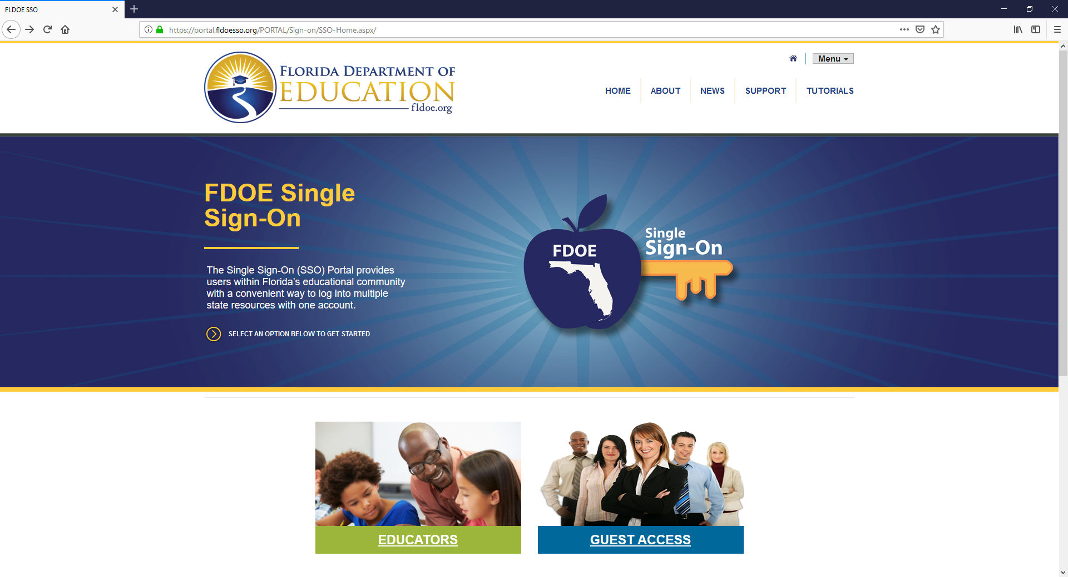

Slide 125
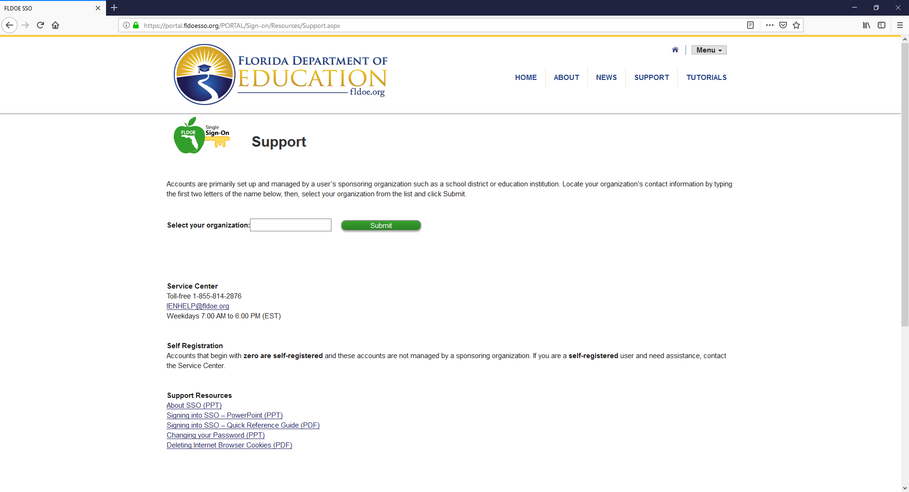
LEA Admin Info
SSO Support Mainline

Slide 126
SSO Roles for Accountability Applications
All roles must be set separately for each application
Roles
  User
    This is the base role
    All district and school level personnel working in the application
  District Administrator
    Primary accountability coordinator or designee
  District
    District personnel working in the application
  School
    School personnel working in the application

Slide 127
Bulk Access Upload File
LEA Admin is able to automate application access
They can contact the SSO helpdesk for assistance

Slide 128
Application Review
Student Data Updates
Assessment Matching
Prior Year Assessment Matching
School Types

